Slide 1


Data Visualization With Matplotlib & Seaborn
-What is Data Visualization?
-Line Chart
-Multi line Chart
-Bar Chart
-Scatter Plot
-Histogram
-Pie Chart
-Box Plot
-Violin Chart
-Heatmap
-Notebook URL

Slide 2

Data Visualization
Data visualization is the graphical representation of information and data. By using visual elements like charts, graphs, and maps, data visualization tools provide an accessible way to see and understand trends, outliers, and patterns in data. Additionally, it provides an excellent way for employees or business owners to present data to non-technical audiences without confusion.
In the world of Big Data, data visualization tools and technologies are essential to analyze massive amounts of information and make data-driven decisions.

Slide 3

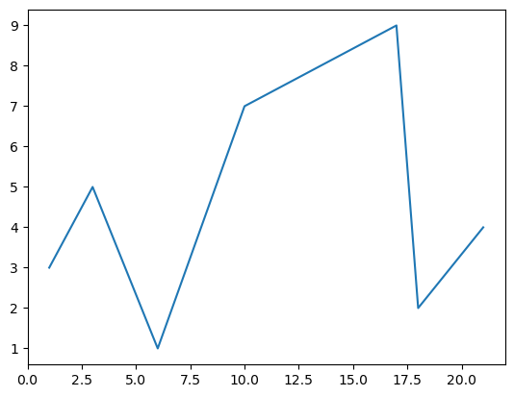
Line chart: The most straightforward way to capture how a numeric variable is changing over time.
-We can plot one or two variables at a time.
Examples:
-One variable(Any thing you can put in 1D list)
-Revenue in $ over time
-Energy consumption in kWh over time
-Google searches over time

Slide 4
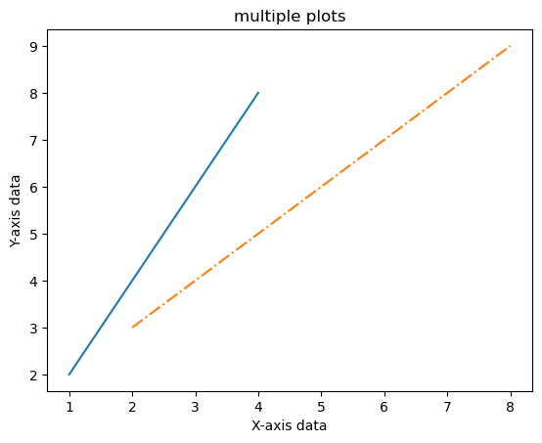
Multi line chart:
Captures multiple numeric variables over time. It can include multiple axes allowing comparison of different units and scale ranges
Examples:
-Apple vs Amazon stocks over time
-Lebron vs Steph Curry searches over time
-Bitcoin vs Ethereum price over time

Slide 5
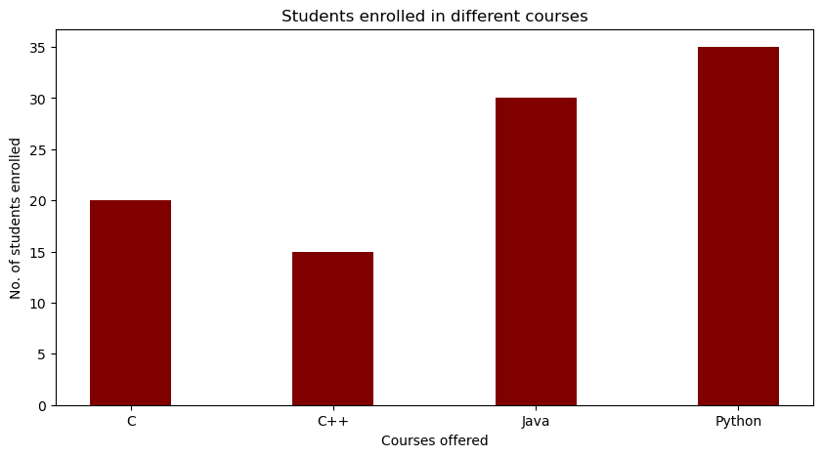
Bar chart:
One of the easiest charts to read which helps in quick comparison of categorical data. One axis contains categories and the other axis represents values .
Examples:
Volume of google searches by region
Market share in revenue by product

Slide 6
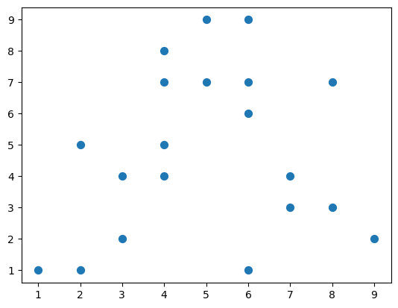
Scatter Plot:
Most commonly used chart when observing the relationship between two variables. It is especially useful for quickly surfacing potential correlations between data points
Examples:
-Display the relationship between time-on-platform and churn
-Display the relationship between salary and years spent at company

Slide 7
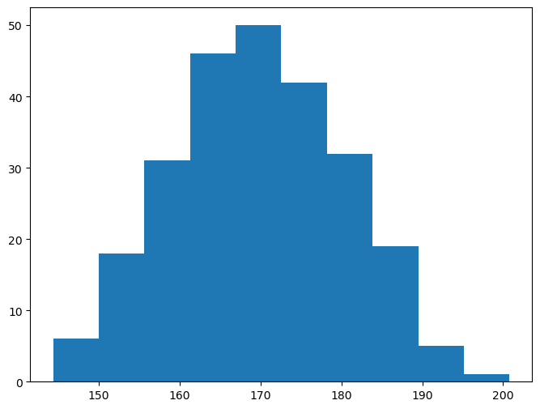
Histogram:
Shows the distribution of a variable. It converts numerical data into bins as columns. The x-axis shows the range, and the y-axis represents the frequency
Examples:
-Distribution of salaries in an organization
-Distribution of height in one cohort

Slide 8
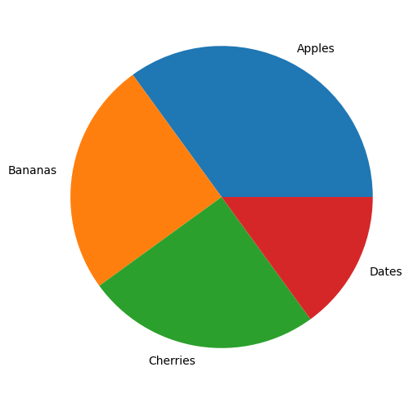
Pie Chart:
One of the most common ways to show part to whole data. It is also commonly used with percentages
Examples:
-Voting preference by age group
-Market share of cloud providers

Slide 9
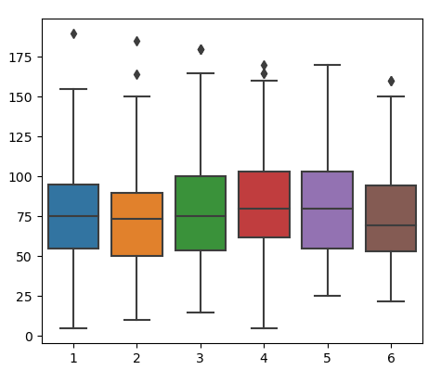
Box Plot:
Shows the distribution of a variable using 5 key summary statistics minimum, first quartile, median, third quartile, and maximum
Examples:
-Gas efficiency of vehicle
-Time spent reading across readers

Slide 10
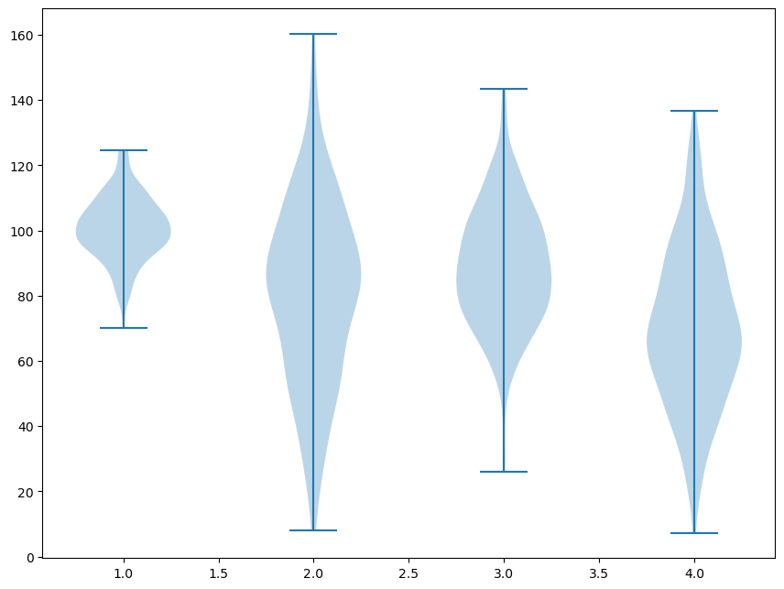
Violin Plot:
A variation of the box plot. It also shows the full
distribution of the data alongside summary statistics
Examples:
-Time spent in restaurants across age group
-Length of pill effects by dose

Slide 11
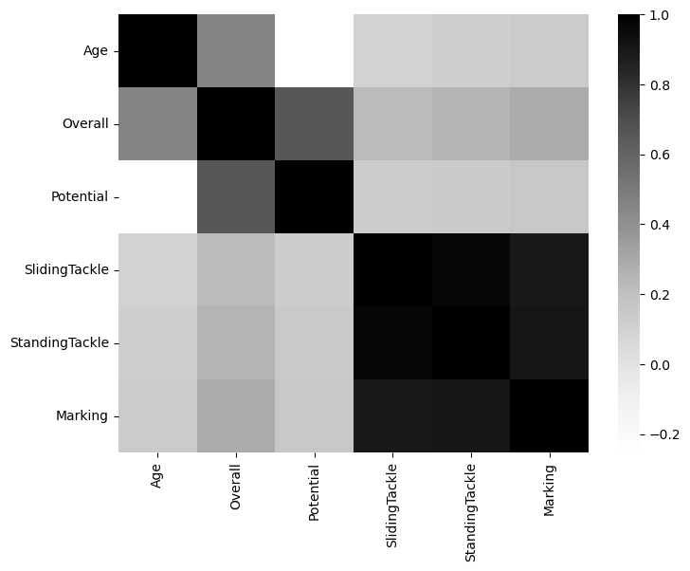
Heatmap:
Heatmaps are two-dimensional charts that use color shading to represent data trends.
Examples:
-Average monthly temperatures across the year
-Departments with the highest amount of attrition over time

Slide 12
You Can Access the Jupyter Notebook from :
https://github.com/omaaralaa/Microsoft-Student-Club-DS/tree/main/Data%20Visualization

Slide 13

THANK YOU
Data Science Team

